Slide 1
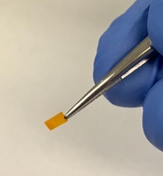
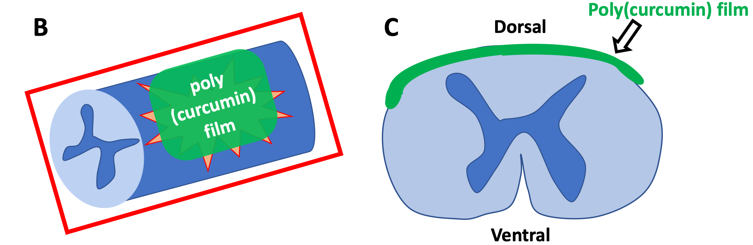
DEPARTMENT of Chemical and Biochemical Engineering
Tissue Scaffolding, Drug and Gene Delivery for Biomedical Applications
Gene Delivery
Lipid nanoparticle delivery of mRNA from electrospun fibers for peripheral nerve regeneration.
Controlled release of LNPs from degradable fibers for sustained vaccine delivery.
Drug Delivery
Protein delivery from electrospun fibers for neural applications.
Poly(pro-drug) polymers releasing curcumin for neural and vascular applications.
Hydrogel Drug Delivery
Intranasal drug delivery using elastin-like polypeptides.
Drug Delivery: Cells (green) taking up elastin-like polypeptides (ELP) (red) for drug delivery applications. Circles depict regions of cellular uptake.
A
Drug Delivery: A) Poly(pro-curcumin) film applied to the dorsal aspect (B and C, schematic) of the injured spinal cord for curcumin drug delivery.
PoC: Ryan Gilbert, Professor and Department Chair
Linda and Bipin Doshi Endowed Chair
Email: ryangilbertmst@gmail.com
Phone: 518-366-8920
Web: https://www.rgilbertlab.com/
Funding:
Department of Veterans Affairs
National Institutes of Health
National Science Foundation
Keywords:
Drug delivery, gene delivery, biomaterials, neural tissue engineering, brain computer interfaces, peripheral nerve injury, spinal cord injury.
Recognitions:
NSF CAREER Award
School of Engineering Teaching Award
Fellow: American Institute for Medical and Biomedical Engineering (AIMBE)

